Slide 1
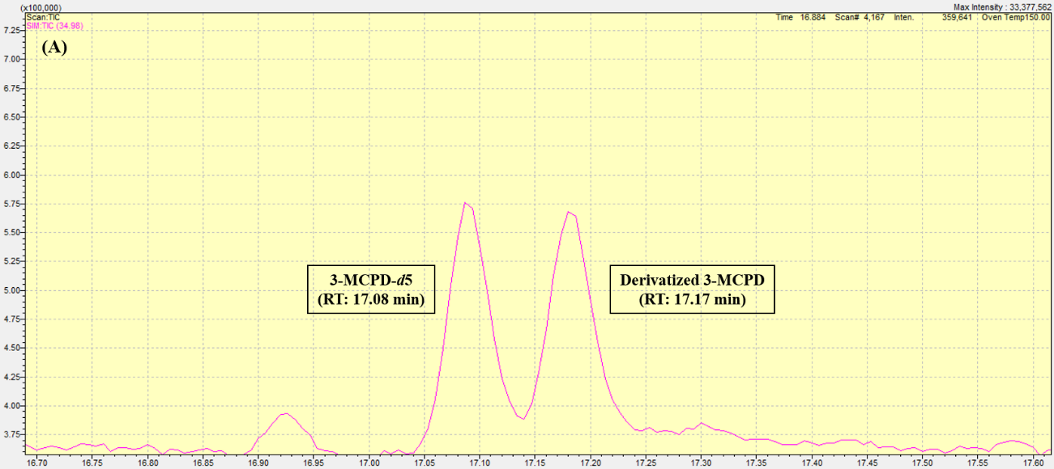
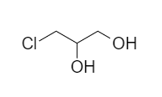
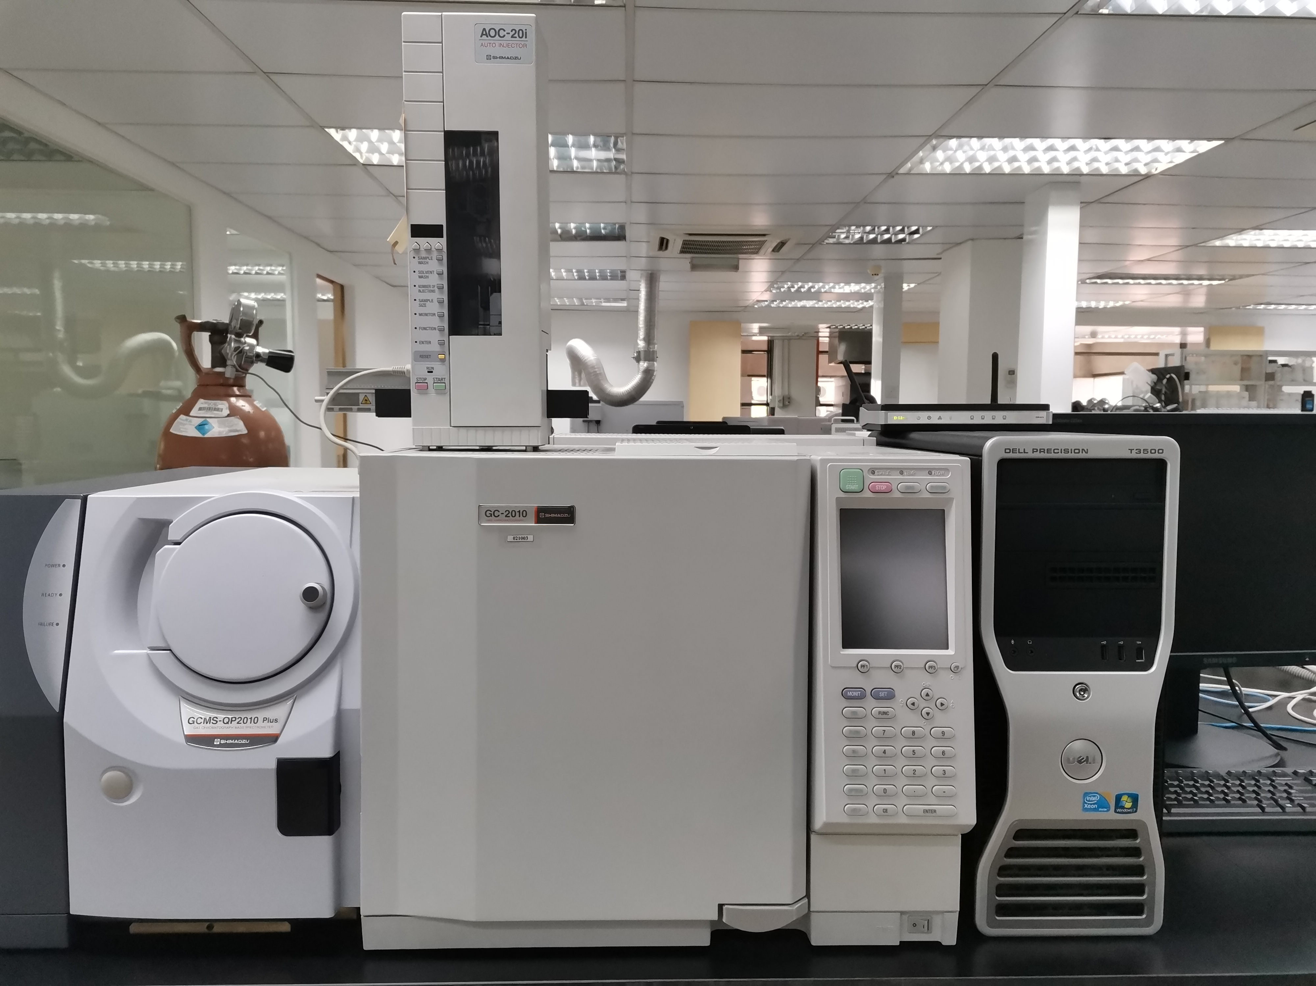
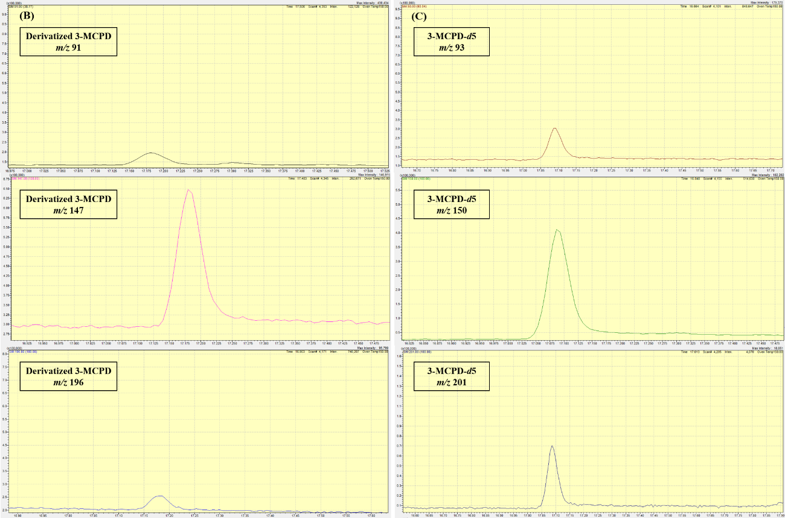
Detection of a single analyte
Single internal standard used
Suitable for routine analysis
Good sensitivity, accuracy, and repeatability
Acidic transesterification
3-MCPD is a contaminant formed when plant oils are refined and deodorized at high temperatures.
GC-MS analysis equipped with BPX-5 capillary column using SIM mode.

